Slide 1
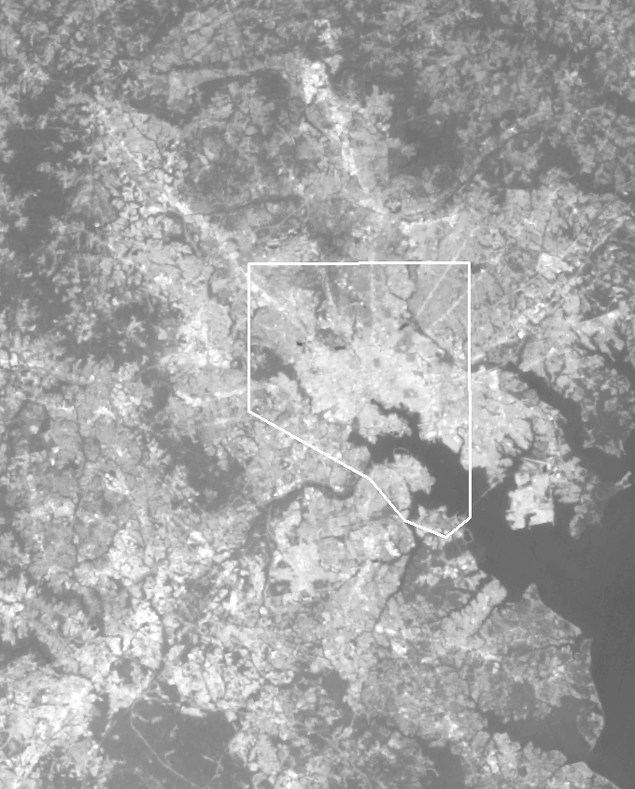
B) How to get to LST
DN
1. AT SENSOR RADIANCE
2. EMISSIVITY CORRECTION
3. AT SENSOR TEMPERATURE
4. ATMOSPHERIC CORRECTION
LST
(digital number) raw image, no unit
LC80150332015229LGN00 Band10
Raw image from Band 10 (Baltimore surrounded by the city line)

Slide 2
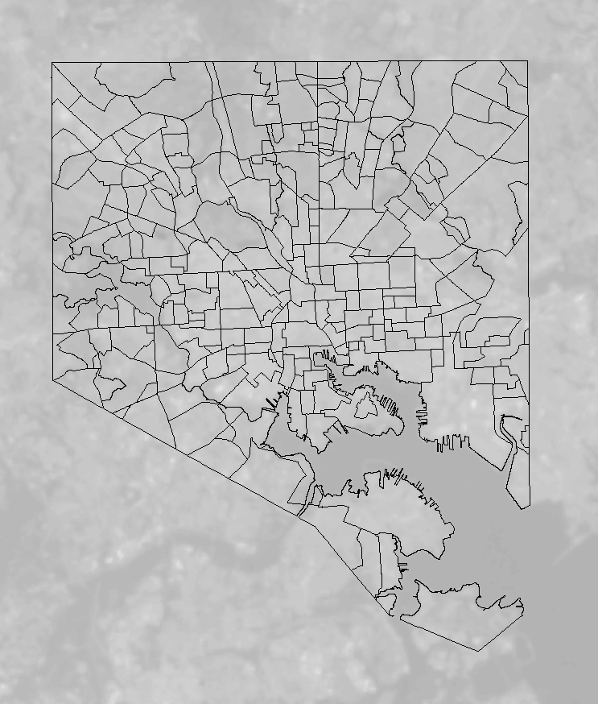
1. Conversion to TOA Radiance
Band 10 DN data can be converted to TOA spectral radiance
L_{λ} = M_{L}Q_{cal} + A_{L}
where:
L_{λ} = TOA spectral radiance (Watts/( m2 * srad * μm))
M_{L} = Band-specific multiplicative rescaling factor from the
metadata
A_{L} = Band-specific additive rescaling factor from the metadata
Q_{cal} = Quantized and calibrated standard product pixel values (DN)

Slide 3
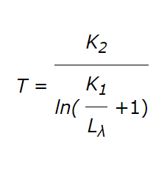
2. Emissivity Correction (Conversion to At-Satellite Brightness Temperature)
Equation of TOA radiance converted to at-satellite brightness temperature
Before the whole equation is completed to convert the spectral radiance into at-satellite brightness temperature; an emissivity correction has to be completed, since different land covers have different emissivity values
The equation assumes that TOA spectral radiance is divided by an emissivity value of 1, meaning it assumed everything has the same value (in the correction this will be changed so that the land cover has the right emissivity value
spectral radiance divided by emissivity
where:
T = At-satellite brightness temperature (K)
L_{λ} = TOA spectral radiance (Watts/( m2 * srad * μm))
K₁ = Band-specific thermal conversion constant from the metadata
K₂ = Band-specific thermal conversion constant from the metadata
Emissivity- measure of the efficiency in which a surface emits thermal energy

Slide 4
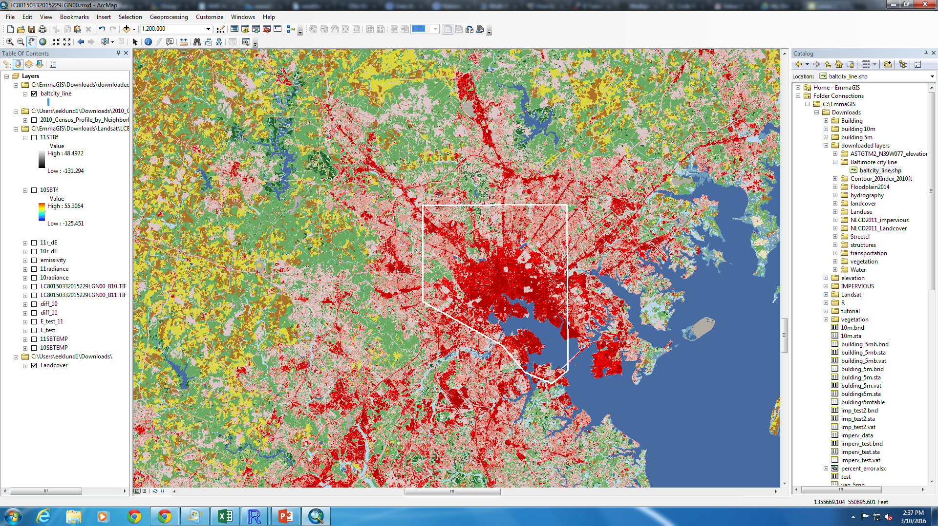
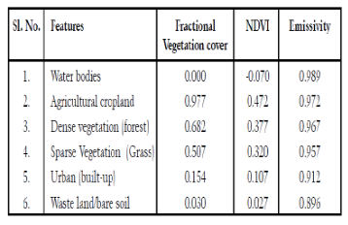
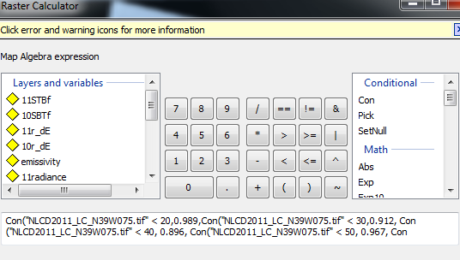
Emissivity correction (cont.)
[2]
Land cover map has different values (signaled by the different colors), converted into emissivity values by using conditional statements on the raster calculator in GIS
Conditional written so that, for example, if the land cover value in the map is less than 20 (water), then to give it an emissivity value of 0.989
This is done for all land features
Land cover map, Image from [4]

Slide 5
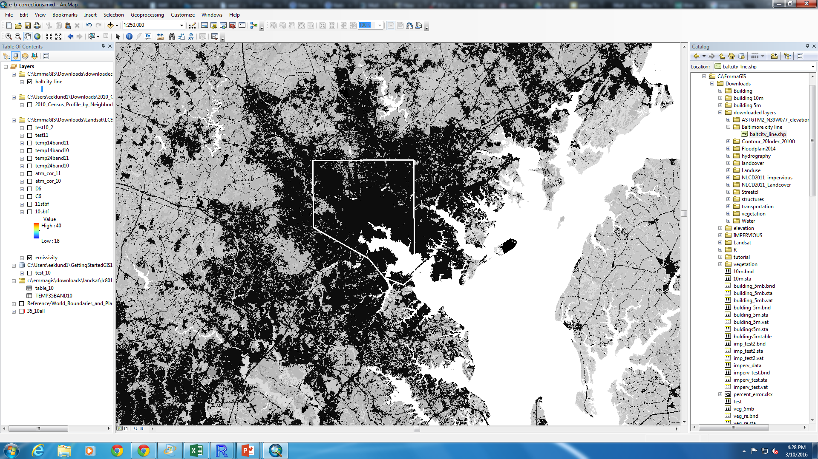
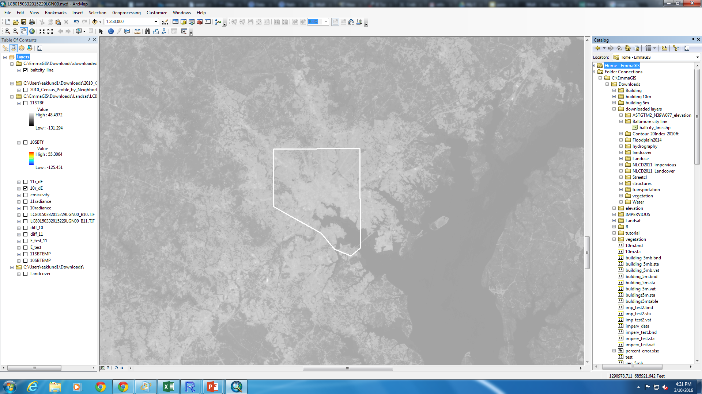
Results for Emissivity Correction
Result:
Close up view of the emissivity map
Band 10 radiance divided by Emissivity

Slide 6
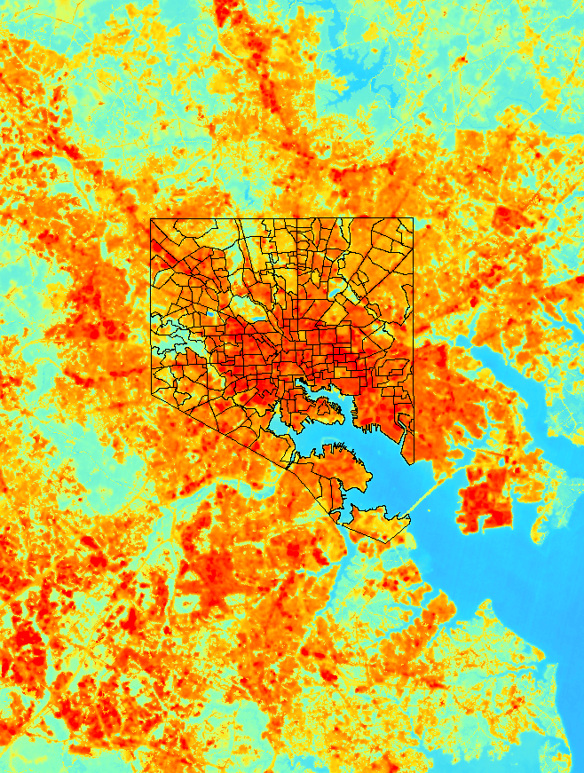
3. Conversion to At-Satellite Brightness Temperature
Result:
After the emissivity correction, there has to be a conversion of spectral radiance to brightness temperature
where:
T = At-satellite brightness temperature (K)
L_{λ} = TOA spectral radiance (Watts/( m2 *srad *μm))
K₁ = Band-specific thermal conversion constant from the metadata
K₂ = Band-specific thermal conversion constant from the metadata

Slide 7
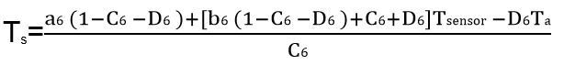
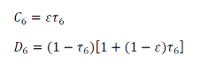
4. Atmospheric Correction: Qin et al.’s mono-window algorithm
From [2]
Constants:
A₆=67.355351
B₆=0.458606
Equations:
w=1.6
T_{o}=35.2℃ (high)
An atmospheric correction is necessary because it would retrieve the surface reflectance by removing atmospheric effect
Tsensor is the at-satellite brightness layer found in step 3
T_{o} was selected as 35.2℃ because it was the high temperature recorded in Olin Hall’s climatological summary for August 17th

Slide 8
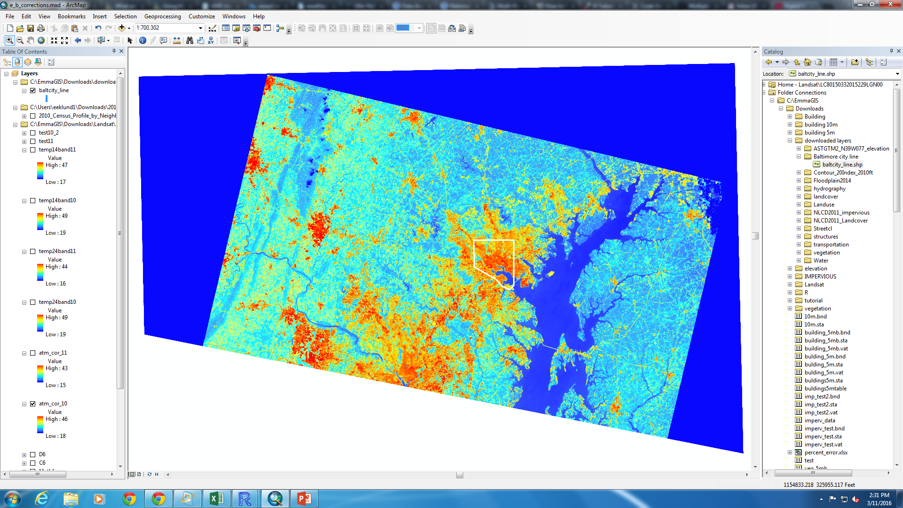
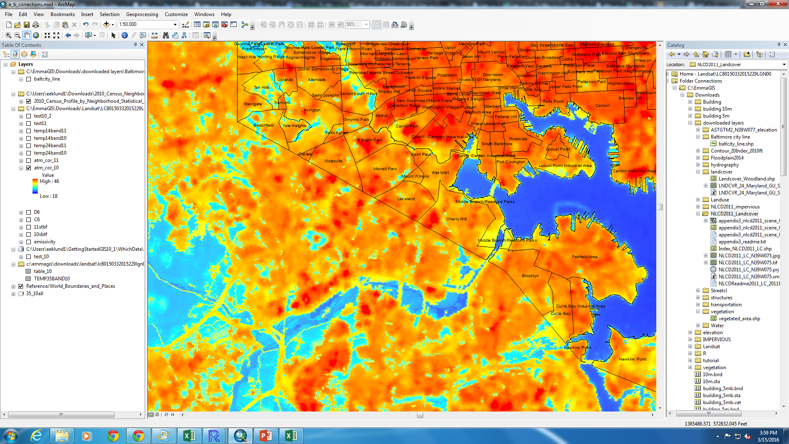
Shows UHI of Baltimore compared to rural areas surrounding it (D.C.’s UHI can be partly seen on the bottom)
Results: LST Band 10 (35.2℃)

